Slide 1
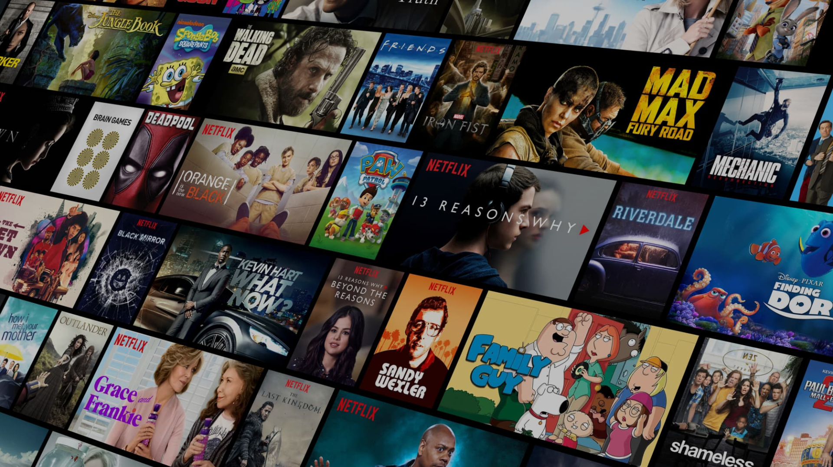
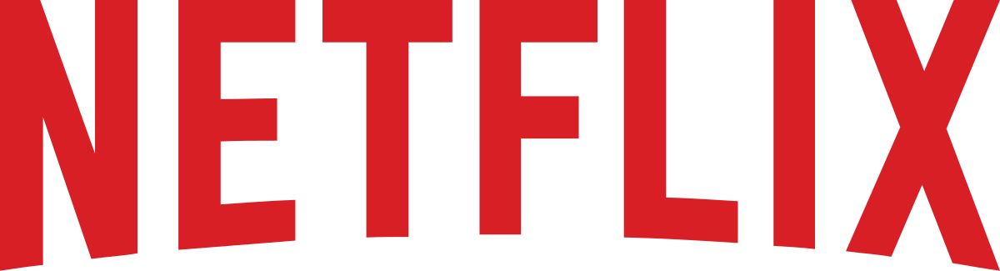


​​Regression Discontinuity Study : Netflix Free Trial
Wanli Chan, Yijie Fu, Guangying Pan, Zhi Zhang

Slide 2
01
Netflix Business Model
02
RD Design & Interpretation
AGENDA
03
RD Validity Analysis
04
Short-term Treatment Impact
05
Long-term Strategic Uses

Slide 3
Business Model - Video On Demand
01
— Less Streaming Volume, Reduced exposure
Netflix Original
–
+
Subscriber
Copyrighted content
+ More revenue, better content for subscribers
— Less Streaming Volume, Reduced exposure
+
Primary KPI: number of U.S. paid membership
Paid Membership: Defined as a membership for which payment has been successfully processed and revenue recognized
* Business Model as of 10/2022
Notes:
Understanding the Direct Network Effect in Netflix's Business Model:
and in this platform there are 3 key component the direct network effect. Starting from the left and moving clockwise, subscribers are Netflix's primary engine. The addition of more subscribers helps Netflix better understand customer preferences and produce superior content, thereby enhancing the subscriber experience. On the other hand, both Netflix Originals and copyrighted content experience a negative direct network effect, as more similar content tends to diverge viewer preferences.
Now, moving to the indirect network effect: Subscriber revenue funds Netflix Originals, which attract more viewers and present a positive reciprocal indirect network effect. Although these originals compete with third-party content, creating a negative relationship, third-party content also draws subscribers, which forms a positive relationship.
Considering the business model, Netflix’s primary Key Performance Indicator (KPI) is the number of paid memberships. It is naturally to consider subscribers as the 'short side' of Netflix’s business model given all the positive flows around subscriber

Slide 4

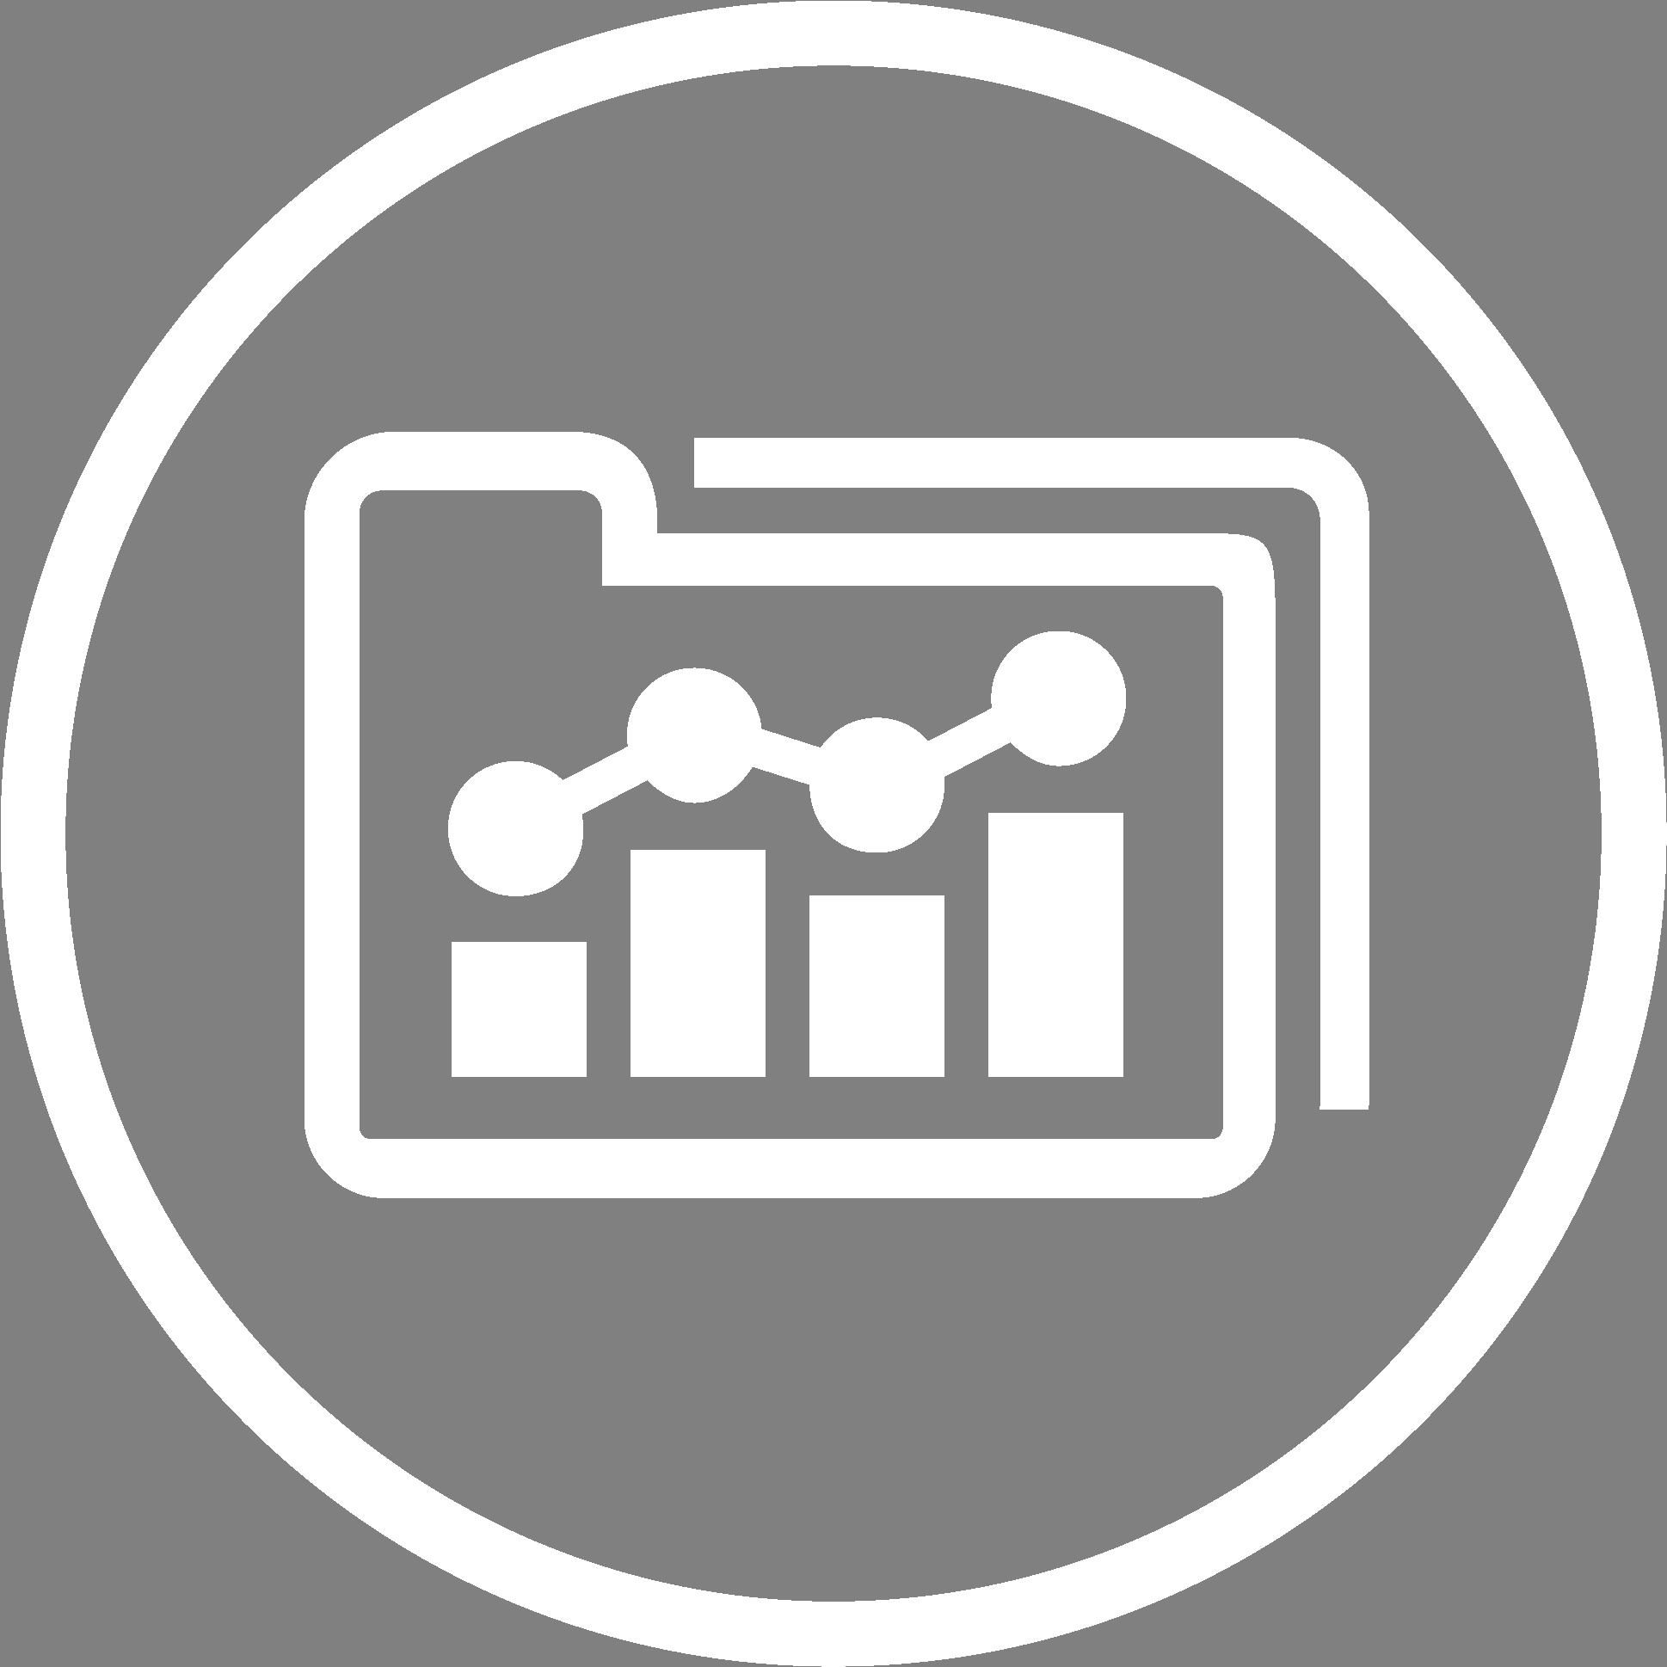

Treatment Discreteness in RD
01
Nature of the Treatment
Company Objective
Discreteness: The offer is binary and clearly defined.
Eligibility: Users who signed up before October 2020 received the free trial. No announcement beforehand
Increase number of U.S. paid membership
Optimize company investment strategy
Applicability for RD Analysis
Regional Focus: United States Only
Cutoff Date: October 2020 marks the end of the free trial promotion.
Treatment vs. Non-Treated: This distinct cutoff provides a clear division between users who received the free trial and those who did not, ideal for Regression Discontinuity analysis.
10/2020
End of One - Month Free Trial
Notes:
Netflix had effort on using a free trial promotion to convert trial users into paying subscribers. However, in October 2020, Netflix canceled this free trial promotion. To understand why the company made this decision, we plan to use a Regression Discontinuity (RD) design to analyze the elasticity of subscriber numbers in response to changes in promotion status. So the nature of treatment, being in trial or not is totally binary and most importantly netflix didn’t announce the cancellation of free trial beforehand, therefore users lack of control over the assignment variable. For the

Slide 5
Hypothesis
02
“Ending Free Trial Will Not Affect
the Number of U.S. Paid Membership”
Notes:
And…we hypothesize that

Slide 6
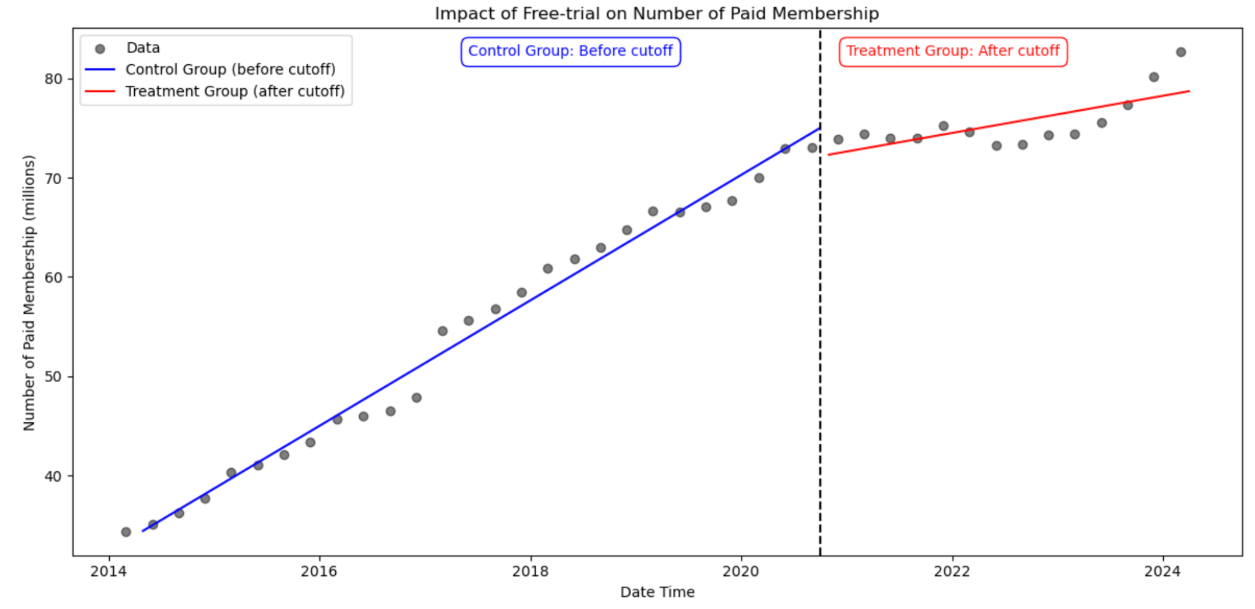
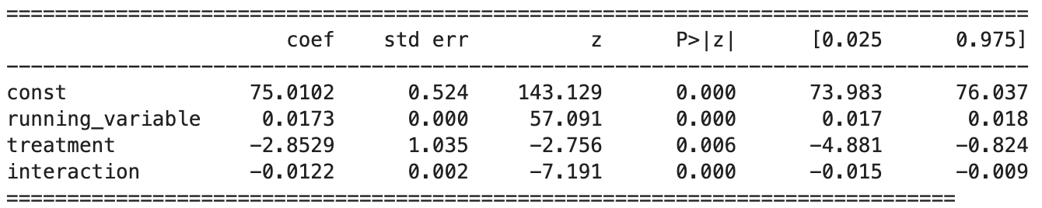
Regression Discontinuity Design
02
Running Variable: Days from Cutoff
Cutoff: Oct 2020
Outcome Variable (millions)
Quarterly Number of U.S. Paid Memberships
Regression Equation
Y = α +τD + β1(X - c) + β2D(X-c) + ϵ
One-month Free Trial
Cancel One-month Free Trial
Treatment Effect
2020/10
τ = -2.8529
Data Sources: Netflix Quarterly Reports, Statista
Reject Null Hypothesis
The treatment immediately decreases U.S. paid memberships by 2.853 million per quarter.
Notes:
on average, the treatment decreases the growth rate by 0.82%

Slide 7
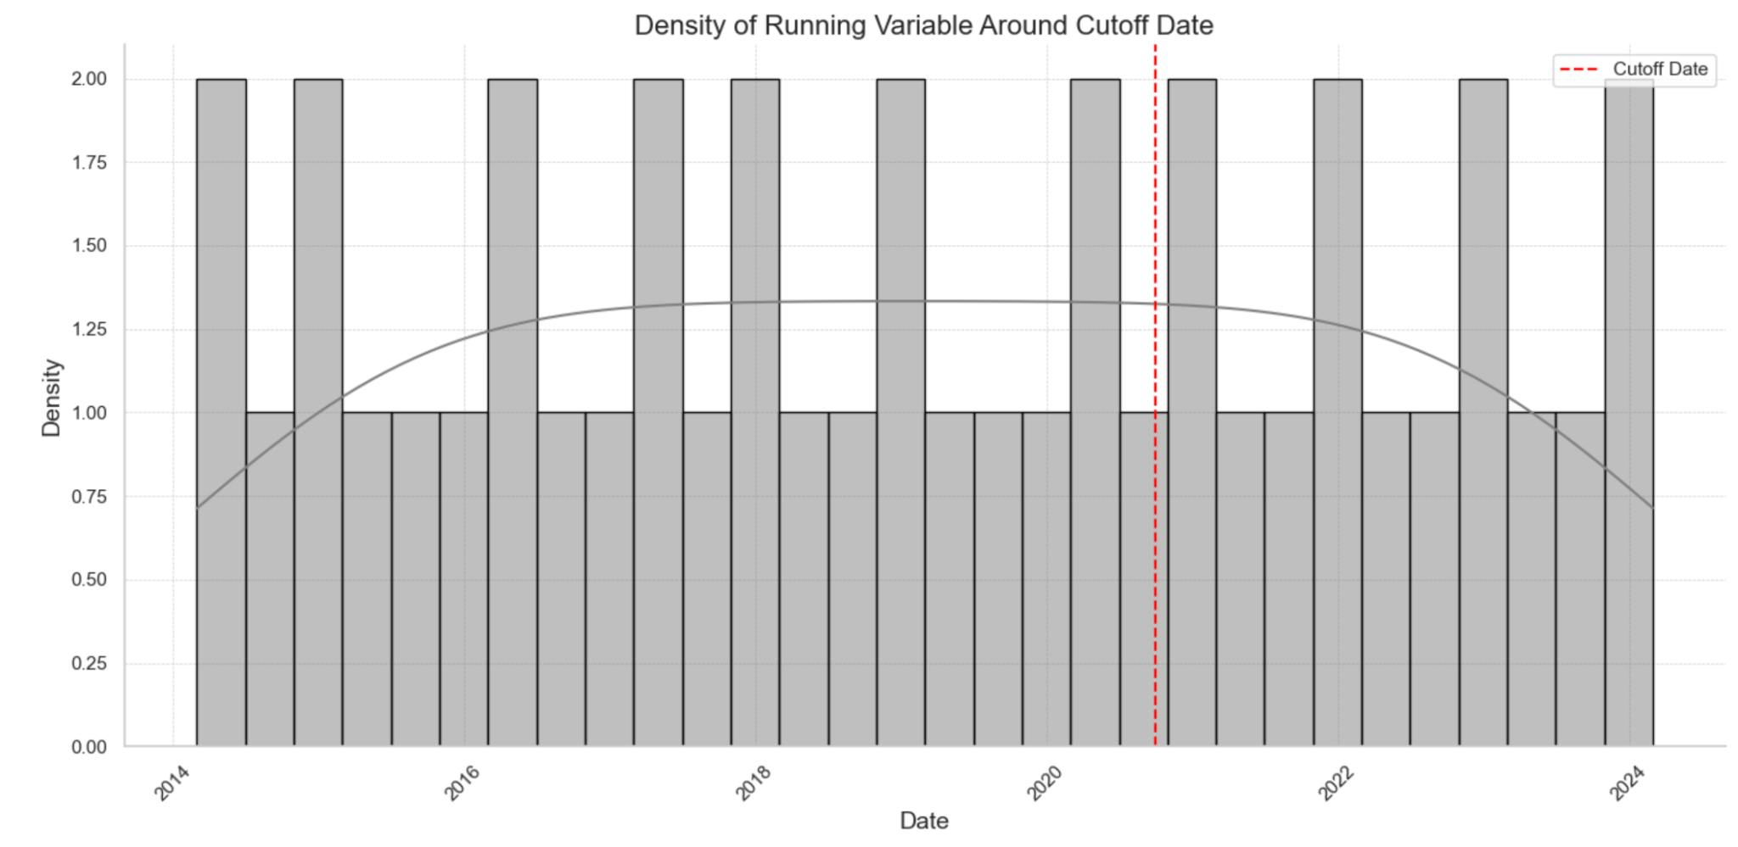
RD Validity - Continuous Running Variable
03
Uniform Distribution
The histogram bars (grey) are relatively uniform on both sides of the cutoff
Continuous KDE Line
Smooth and continuous across the cutoff point, with no sharp jumps or drops
Valid: No Discontinuity + No Manipulation
Observations to the treatment or control group is likely random around the cutoff.
The treatment effect is not due to manipulation of the running variable
Notes:
on average, the treatment decreases the growth rate by 0.82%

Slide 8


Validity Conditions for RD Analysis
03
Strict Cutoff Enforcement
Omitted Variable Bias
Users before and after the cutoff clearly distinguished by free trial receipt
No omitted variables vary systematically at the cutoff point
Continuity of
Running Variables
Balance of Baseline Covariates
Days from cutoff date continuous and not manipulated
No advance notice of trial termination
Characteristic of baseline covariates on both sides of the cutoff are similar
Notes:
It’s also crucial to ensure that baseline covariates are balanced on either side of the cutoff.
Helps:
Controlling for Confounding Variables
Ensuring Balance Across Treatment Groups
Enhancing Precision of Estimates

Slide 9
Testing Validity with Baseline Covariates
03
Customer Demographic
Marketing Exposure
Age and gender distribution of users signing up before and after the cutoff should be similar
Extent of users exposed to Netflix marketing campaigns should be similarly before and after the cutoff
Customer Behavior
Historical viewing behavior (engagement, views time, view preference) of users should not change abruptly at the cutoff
Notes:
To further demonstrate we should first gather all these data and to control for customer demographic, such as 1 2 3, all these should be…

Slide 10
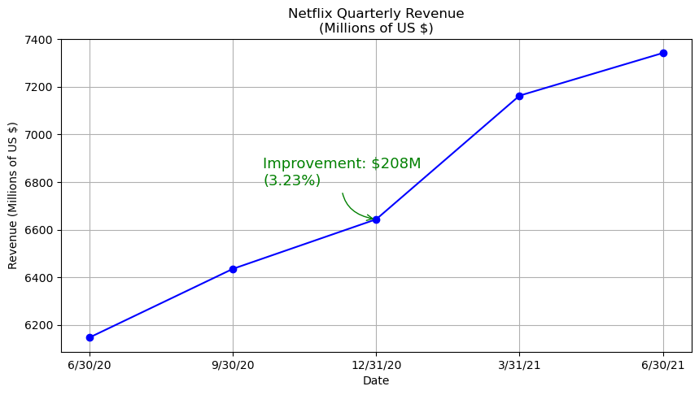


Short Term: Impact of Revenue
04
Number of Subscriber Drop
Steady Increase Of Revenue
BECAUSE
∂ Revenue
∂ Revenue
∂ Paid Membership
∂ Other Factors
Treatment would affect other outcomes, such as revenue. They cannot be isolated completely.
A comprehensive analysis needs to consider interdependencies.
Notes:
Although # of the number membership is our primary outcome, we also care about other KPI such as Revenue. As seen earlier in the model diagram, the Immediate effect of ending the program results in a drop of subscribers, Netflix revnue steady trending up. There are other component that offset the negative effect causing by decrease of 。By enforcing paid memberships and purying its customer base to those who are willing to pay for good content actually .

Slide 11
Long Term Strategic Uses of RD
Estimates for Netflix
05
💡
Key takeaway: adjust Short-Sided Market Focus from subscriber to content development
Strategic Implications
Investment Shift:
Prioritize content development over subscriber promotional offers.
Allocate resources towards developing new and engaging content.
Next Step
Measure Impact:
Assess how new content influences subscriber growth and retention.
Compare the effectiveness of content investment against traditional promotional tactics.

Slide 12

Thanks

